Slide 1

Introduction to Azure Cosmos DB
Will Velida | Software Engineer | Microsoft Data Platform MVP

Slide 2


About Me
Software Engineer based in Auckland.
Microsoft Data Platform MVP
Azure Cosmos DB, Azure Functions, .NET and more!

Slide 3

What we’ll be talking about today
What is Azure Cosmos DB?
What can we use it for?
Data Modelling.
Partitioning in Cosmos DB
Understanding Throughput in Cosmos DB.
Q&A

Slide 4



Azure Cosmos DB
A globally distributed, massively scalable, multi-model database service
SQL
MongoDB
Table API
Column-family
Document
Key-value
Graph
Guaranteed low latency at the 99th percentile
Elastic scale out
of storage & throughput
Five well-defined consistency models
Turnkey global distribution
Comprehensive SLAs
Notes:
Azure Cosmos DB is Microsoft's globally distributed, multi-model database service. Using Azure Cosmos DB, we can build databases using a variety of different data modles
We can build applications that use Document models using either the SQL and MongoDB API, Columnar data using the Cassandra API, Key Value data using the Table API or Graph data using the Gremlin API.
Cosmos DB provides you the ability to build highly responsive and available applications worldwide ensuring that your data is close to wherever your users are,
The Key Benefits of Benefits of Cosmos DB are:
Turnkey Global Distribution
Cosmos DB replicates your data to wherever your users are. We can add or remove any Azure regions to your Cosmos DB account at any time. Cosmos Db will replicate your data to all regions associated with your account while your application continues to be highly available.
Elastic Scalability of throughput and storage world wide
Cosmos DB offers elastic scalability for your reads and writes around the globe. You can scale up from thousands to millions of requests per second and only pay for the throughput you need to help you deal with any spikes in workload.
Guaranteed low latency at the 99th Percentile, worldwide
With Cosmos DB, you can build highly response, planet scale applications. Cosmos DB guarantees less than 10ms latencies for both indexed read and writes at the 99th percentile, which provides rapid queries and responsive applications.
Precisely defined, multiple consistency choices.
With Cosmos DB, we no longer have to choose between two consistency extremes, Cosmos DB provides 5 well-defined levels of consistency for us to choose from depending on our application requirements.
No schema or index management (with caveats)
Cosmos DB automatically indexes all data and is schema-agnostic, meaning we don’t have to worry about application downtime or managing schemas or indexes.

Slide 5

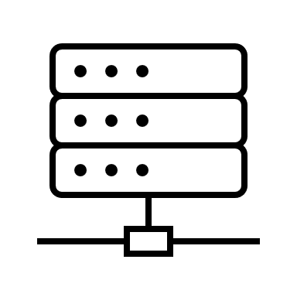


Why NoSQL?
Flexible Schemas
Horizontal Scale-Out
Fast queries
Easy for Developers
Notes:
Flexible data models
NoSQL databases typically have very flexible schemas. A flexible schema allows you to easily make changes to your database as requirements change. You can iterate quickly and continuously integrate new application features to provide value to your users faster.
Horizontal scaling
Most SQL databases require you to scale-up vertically (migrate to a larger, more expensive server) when you exceed the capacity requirements of your current server. Conversely, most NoSQL databases allow you to scale-out horizontally, meaning you can add cheaper, commodity servers whenever you need to.
Fast queries
Queries in NoSQL databases can be faster than SQL databases. Why? Data in SQL databases is typically normalized, so queries for a single object or entity require you to join data from multiple tables. As your tables grow in size, the joins can become expensive. However, data in NoSQL databases is typically stored in a way that is optimized for queries.
Easy for developers
Some NoSQL databases their data structures to those of popular programming languages. This mapping allows developers to store their data in the same way that they use it in their application code. While it may seem like a trivial advantage, this mapping can allow developers to write less code, leading to faster development time and fewer bugs.

Slide 6






Use Cases for Azure Cosmos DB
Web Apps
IoT Apps
Recommendation Engines
Retail and E-Commerce
Gaming Apps
Serverless
Notes:
We can use Cosmos DB in a variety of different use cases.
We may have IoT applications that require us to read telementary recordings from devices across the globe, we may have a mobile game that’s used by gamers all across the globe and we need to bring their data as close to them as possible for rapid performance.
We may have web or retail applications with customers all across the globe and we need to be able to provide them with ultra fast retail shopping experiences.
Essentially, if we need a NoSQL database service that’s ultra fast and requires minimal management., then Azure Cosmos DB is a great choice for our data requirements.

Slide 7



Initial Questions
Why should I care about data modelling in Cosmos DB?
How is it different to relational database modelling?
How do we express relationships in our data?
Notes:
When we’re modelling our data for our applications that will use Cosmos DB, we might ask ourselves the following questions:
Why should I care about data modelling in Cosmos DB when it is a schema-free data store?
How is data modelling different in Cosmos DB compared to what data modelling is when we’re developing applications that use relational data stores?
How do we express relationships in our data store bearing in mind that Cosmos DB is non-relational?

Slide 8



Scenario: Online Book Store
Notes:
To answer these questions, we’ll use an example of an online book store. So in this application we’d store information about books, authors of those books and in this example we could hold information on reviews of those books that users or customers would make on particular books

Slide 9


Relational Data Model
Authors
Id
FirstName
LastName
BirthDate
Book
Id
AuthorId
BookName
BookDescription
BookGenre
ReleaseDate
AverageRating
Price
Reviews
Id
BookId
Rating
RatingDescription
Primary Key
Foreign Key
Notes:
So lets take a look at how this might be modelling using a relational database. With relational data stores, we would normalize our data and break each entity into discrete components. So here a book can have an author, books can have multiple reviews, Authors can have write multiple books.
The idea behind normalization is to avoid storing redundant data and refer to other data, so for example if we wanted to retrieve all the books that were written by a particular author (next slide)

Slide 10
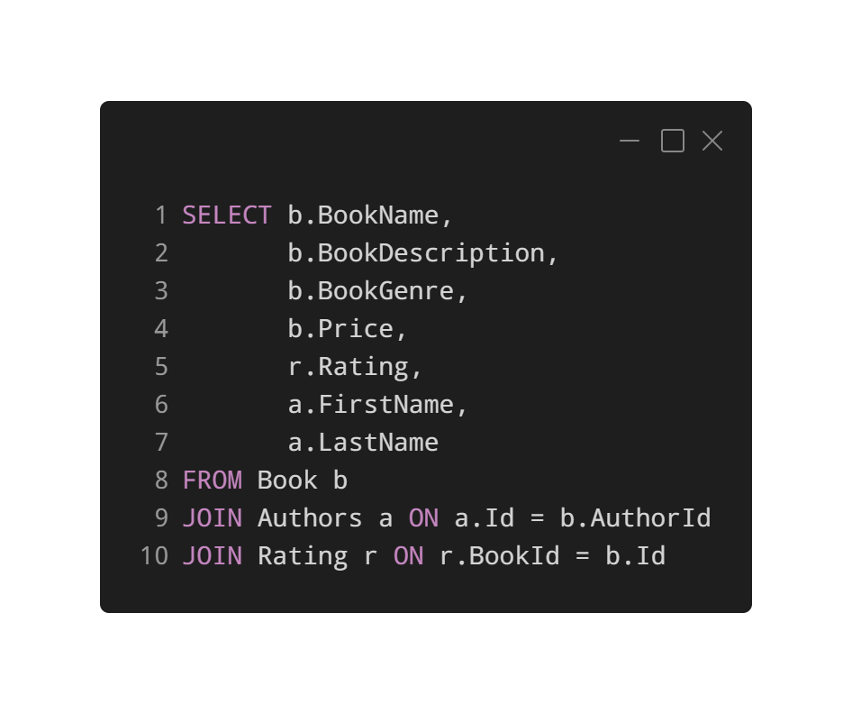
SQL: Retrieving all books for a Author
Normalizing data avoids storing redundant data.
Refer to other data.
Implement Joins to denormalize the data back to us.
Updating information would require write operations across different individual tables.
Notes:
We would have to write the following SQL query, essentially to get a book for an associated author along with the ratings of the books that they’ve written, we’d need to use Joins to denormalize the data back to us whenever we would want to see that.
Alternatively, updating all this information would require us to perform write operations across different individual tables.
Now you might be watching this thinking, why wouldn’t we take this same approach in Cosmos DB? It makes sense to keep discrete entities in separate tables and you’ve said that Cosmos DB doesn’t care about document schema, so why should this be any different in Cosmos?

Slide 11
Problems with this approach in Cosmos DB
No support for JOINs across containers
Throughput considerations.
Multiple, Messy Operations.
Notes:
Well there are a couple of problems with having separate tables (or containers as they are known in Cosmos).
Cosmos DB doesn’t have support for joins across containers. So right from the start, you won’t be able to join data sitting in one container to data sitting in another.
Taking this approach also has cost repercussions, not just technical ones. We haven’t talked about Throughput yet, but depending on how you provision throughput on your databases and collections in Cosmos DB, having a bunch of different collections may not be the most efficient approach to take.
Finally, performing operations across these different collections will be messy. You may have to perform SQL like joins on your data in memory, which may require multiple reads. Then trying to update your data all over the place will mean you’ll have to perform multiple writes all over the place.

Slide 12
Data Modelling Options
Embedding
Referencing
Hybrid
Document Types
Notes:
Well, with Cosmos DB, we have a few options at our disposal.
We can use Embedding in our documents.
We can reference data in some documents that reference to data in other documents.
We can use a bit of both using a Hybrid approach
Or we can be really ambitious by storing different document types within the same container.
Let’s take a look at embedding first

Slide 13
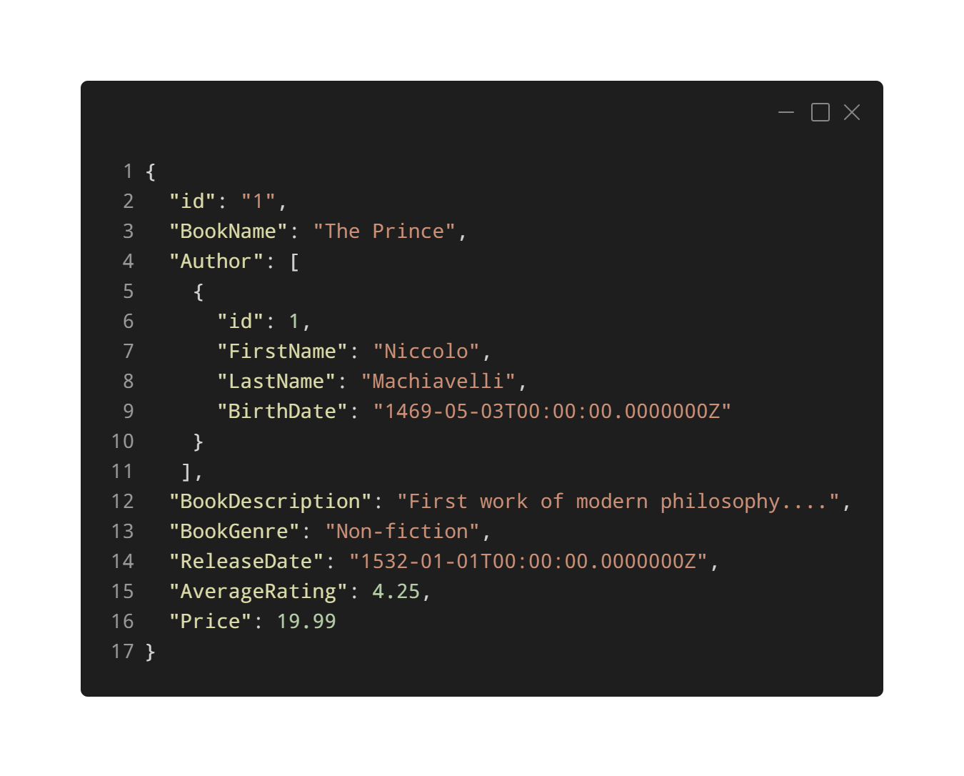
Embedding Data
Notes:
With Embedding, we treat entities in our model as sel-contained items in our documents. So here, I have a Book, with an Author entity embedded inside our Book document. Now, all our information related to this book is now embedded into a single document. So querying for this book doesn’t require any elaborate joins to multiple tables.
One document, one collection, one request. Getting this book is a single read operation. Updating it is a single write operation. Nice and simple ☺

Slide 14
When can we use embedding?
Contained Relationships between entities.
One-to-few relationships between entities.
Embedded data changes infrequently.
Embedded data doesn’t grow without bound.
Embedded data is queried frequently together.
Notes:
The general guidelines for using embedding are straight forward. Read points on screen.
Now let’s take a look at referencing.

Slide 15
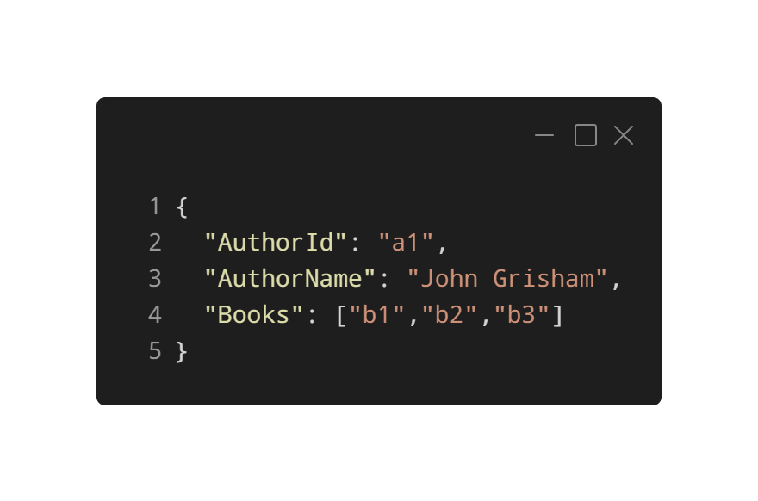
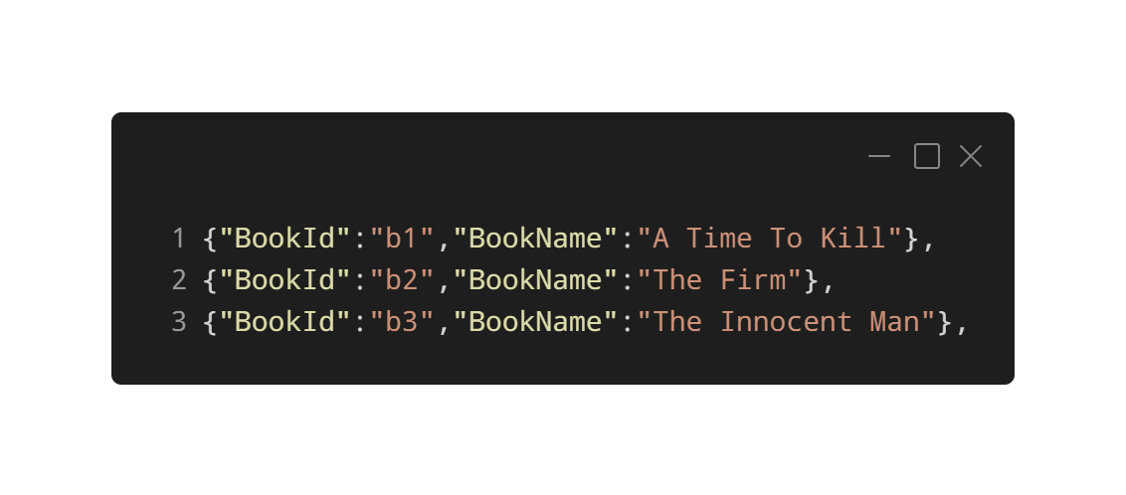
Referencing Data
Notes:
Now bear in mind that despite being non-relational, we will still have relationships in our data that we store inside Cosmos DB. Now if we need complex relationships, it would be better if we stick to relational data stores, but if we have simple relationships, we can use referencing.
Let’s take the following example, now some authors in our application might publish more books than others and it may be impractical to store all the books they’ve written in the same document. So we could add a reference to the books they have written in another document. This approach is great if we have arrays in our data that are unbounded, or in other words, can grow to an unlimited size.
We can even avoid having the book array in our author document here by adding a reference to the author within our book document. So with referencing, we have a couple of options at our disposal to optimize our data models.

Slide 16



When should we use Referencing?
Represents one-to-many relationships.
Represents many-to-many relationships.
Related data changes frequently.
Reference data can grow without bound.
Notes:
Here are the guidelines we should follow if we want to use referencing in our data.
If we have one to many relationships or many-to-many relationships, we can benefit from referencing, particular when it comes to heavy duty write operations.
If the related data changes frequently, then referencing the frequently changing data would be better than embedding it.
If our referenced data grows without bound, that means the referenced data has a unlimited size, then referencing this data is a good approach to take.
Of course, thanks to the schema-agnostic nature of Cosmos DB, we aren’t limited to choosing only one approach, we can use hybrid of both embedding and referencing depending on the nature of our data.

Slide 17
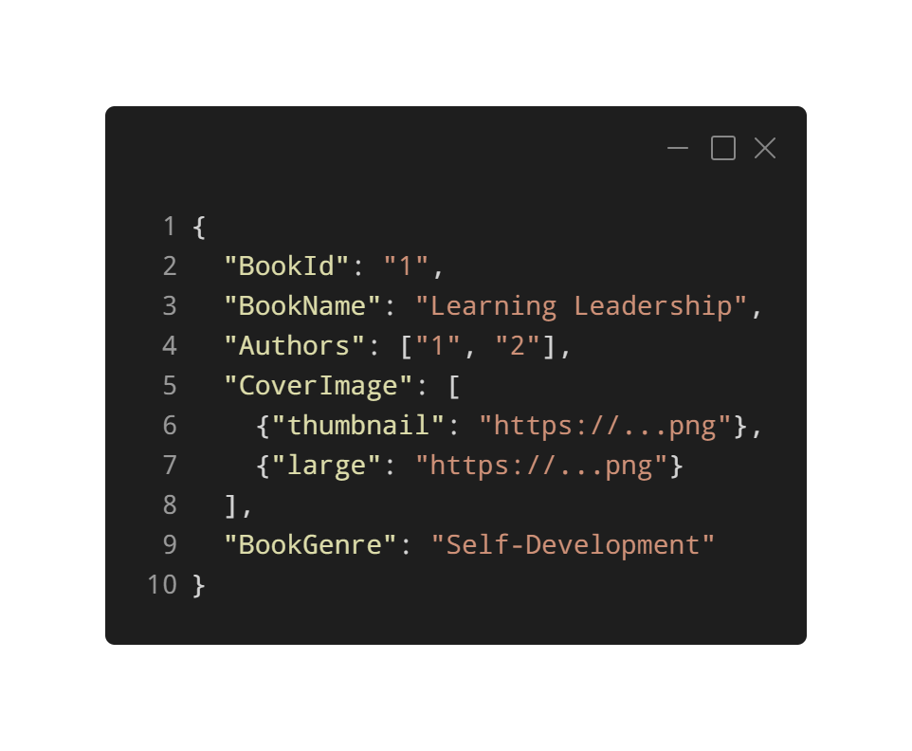
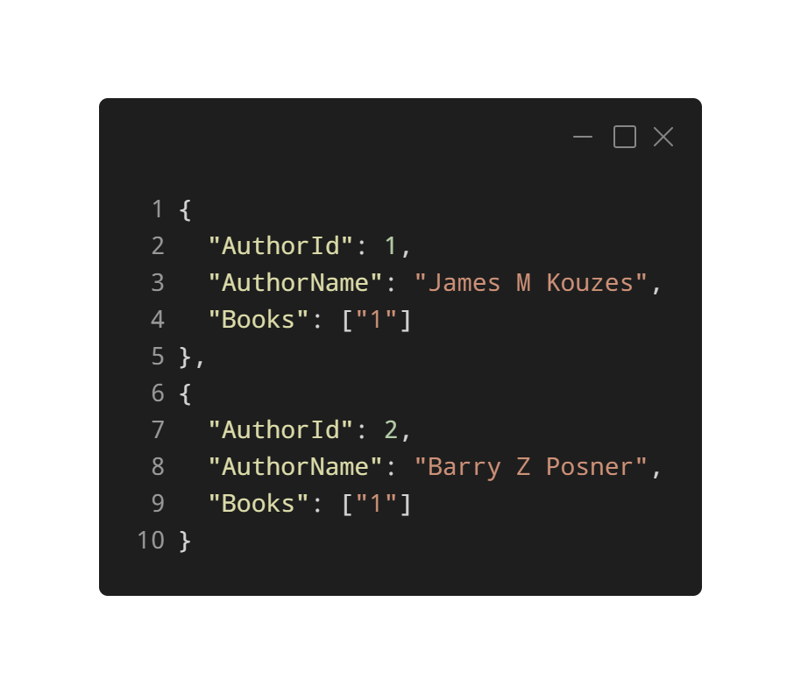
Can we mix and match?
Notes:
Take the following example. Here we’ve got a book document that embeds data that stores our Cover Image of our Book and then uses referencing to reference the authors of our book. Using this approach, we can make a single write operation to update information about our books without making updates to our authors and if we need to make an update to our authors, we can perform a single write operation on our author document.
With this approach, we’re referencing our author Id in our book document. If we wanted to be really adventoures, we could insert both these documents within the same container.

Slide 18
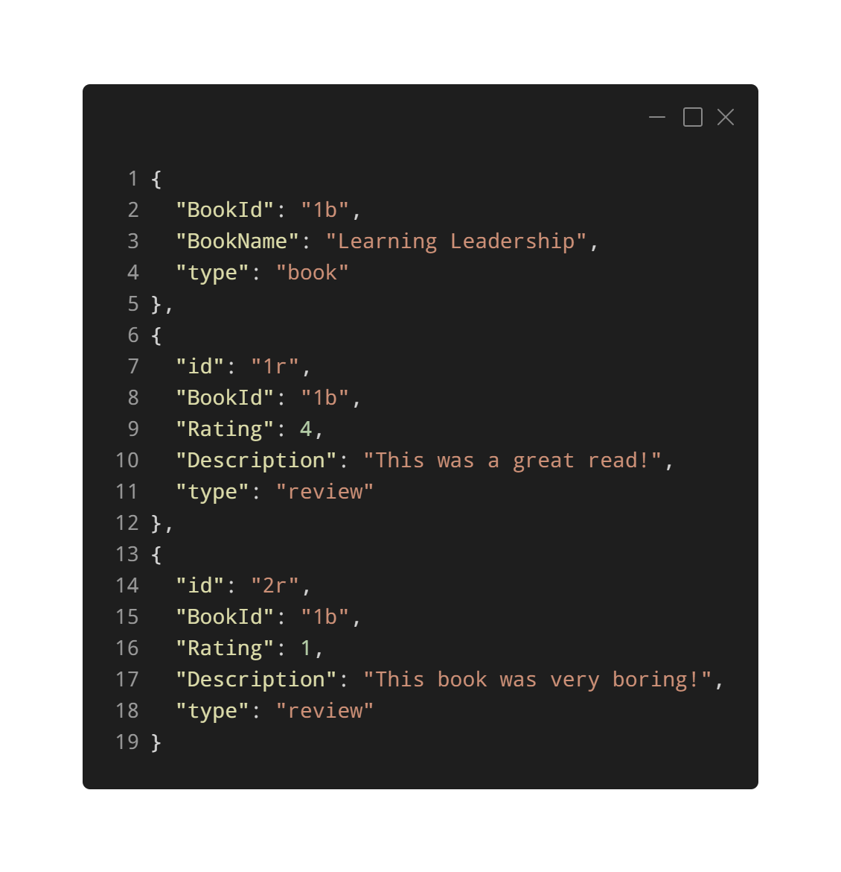
Different Document Types
Notes:
Now I suspect you might be thinking that I’m being a little too ambitious here, but let’s take the following example. Here we have Books and Reviews within the same container.
We have a Book document at the top here, followed by two review documents that have a reference to the book id as part of their schema. What’s important to note here is that we have a property called type that differentiates between our documents.
Using this method, we can query the same container and then perform inner joins on our documents if we wanted to see all the reviews of a particular book.
We would take this approach when we have multiple related documents that sit within the same partition inside our collection. I’ll talk about partitioning in my next video.

Slide 19
How Partitioning Works
Cosmos DB uses partitioning to scale containers to meet performance needs.
Items in our containers are divided into logical partitions.
These are based on the value of a partition key that is associated with items in our containers.
All items in a logical partition have the same partition key value
These logical partitions are then mapped to physical partitions behind the scenes.
Notes:
So how does Partitioning work in Cosmos DB?
Partitioning is used to scale individual containers in a database to meet the needs of our applications.
Every time we persist an item into our containers, they are divided into something called logical partitions. These are based on the value of a partition key that is associated with an item that we store in our containers.
Items within a logical partition will all have the same partition key value. This will be a property within our documents, so for example, if I had a container that was storing items related to hotels, and we gave that container a partition key of CityName and we had 20 different CityName values in our container, we would have 20 logical partitions created for that container.
These logical partitions are then mapped to physical partitions. These are a internal implementation of the partitioning system and they are managed by the Cosmos DB team. Just for your information, Physical partitions just essentially are a fixed amount of reserved SSD-backed storage and compute. Let’s illustrate this with an example.

Slide 20
Partition Key Value:
/CityName
10K RU
50GB
Auckland
Sydney
New York
London
Dublin
Seattle
Redmond
Paris
Partition 1
Partition 2
Partition n
Notes:
So in this example, let’s say we have a container containing hotels that’s partitioned by CityName, so every time we add a document to our hotel container that has a CityName value of Auckland, it would be placed inside that logical partition, and let’s say we add a bunch of documents and each time new logical partitions are created. These will then be mapped to Physical Partitions.
One or more logical partitions can be mapped to a single physical partition, so we have our logical partitions for Auckland, London, Redmond and Paris all placed inside our Physical partition here. Now depending on the size of these logical partitions, we may only require a single physical partition. Remember we don’t manage these physical partitions. The Cosmos DB team does that. But we do need to consider a couple of things that physical partitions depend on.
The amount of throughput that we provision on our containers. Each physical partition can provide a maximum of 10,000 RU’s. I’ve been in situations where we’ve cracked up our RU amount to 1,000,000 and this doesn’t work due to the limitation on the physical partitions.
The amount of storage. So each physical partition can store up to 50GB of data
Now there is no limit to the amount of physical partitions that our containers have. As our data grows and the amount of throughput we provision grows, Cosmos DB will automatically create new partitions by splitting existing ones without affecting your application’s availability.
When our physical partitions split, the data in a logical partition will still remain within the same physical partition. All that happens with the split in physical partitions is a new mapping of the logical partitions to physical ones.
Throughput that is provisioned on a container will be divided evenly among our physical partition. In terms of partition design, it’s important that we get this right to prevent something called ‘hot’ partitions.

Slide 21
Hot Partitions
Storage or Throughput threshold
Paris
London
Auckland
Redmond
Dublin
Notes:
Hot partitions occur within our Cosmos DB containers when our partition key doesn’t distribute the amount of throughput or storage efficiently. This results in rate-limiting and inefficient use of throughput, which in turn leads to higher costs.
So let’s use our Hotel container example again, say if we have a bunch of documents that belong to different cities and they look fairly evenly distributed. But then we have lots of documents that have a CityName partition value of Paris. It looks like there’s a lot of them and almost exceeding the threshold in terms of storage or throughput. This partition is what we would call a Hot partition.
If this was our application, we would have to reconsider using CityName as our partition key, as it’s important that our partition key evenly distributes throughput consumption and storage.
With this in mind, let’s talk about how we can prevent this with good partition key design.

Slide 22
Partition Key Components
Partition Key Path /CityName
Partition Key Value Auckland
Notes:
Partition keys have two components. The path and the value. Using our hotel example from before, we can see that the Partition Key path is CityName. Partition Key Paths in Cosmos DB accepts alphanumeric and underscore characters and you can even set a partition key path on nested objects using path notation.
The partition key value, is the value of our property. So in this example, Auckland would be the value of the Partition Key. This value can be string or numeric types.
Selecting partition key is simple, but it’s critical to get this choice right. In Cosmos DB, once we’ve selected a partition key, it’s not possible to change it. If you do need to change it, you’ll have to create a new container with your new partition key and then migrate it from the old container to the new one. Trust me, that’s a heck of a process, so my recommendation here is that you spend a bit of time thinking about how you’re going to partition your data.

Slide 23
Good Partition Keys have
A value that does not change.
A wide range of values.
Spread Throughput and Storage evenly across logical partitions.
Notes:
Good partition keys will have properties with values that do not change. One you’ve committed your item with a partition value, we can’t then update this value.
They should also have a wide range of values to ensure even distribution across logical partitions in terms of throughput and storage.
This in turn will ensure even throughput consumption and storage distribution across our physical parition

Slide 24
Workload Considerations
Pick a partition key value that appears frequently as a filter.
Use item id to ensure cardinality of partition keys.
Notes:
Our choice for our partition key will depend on the workload that our containers will be performing.
For read-heavy containers, we may wish to choose a partition key property that appears frequently as a filter in the queries that we perform. If we are querying frequently on a certain property, this could be a good choice for our partition key.
For write heavy containers, we may want to use the id of a document as our partition key value. ID is guaranteed to exist in every item in our Cosmos DB containers, this item id has to be unique, so this can help us achieve even distribution in terms of throughput and storage. If we have to query our items and we know this item id when querying it, this is great for performing efficient point reads

Slide 25
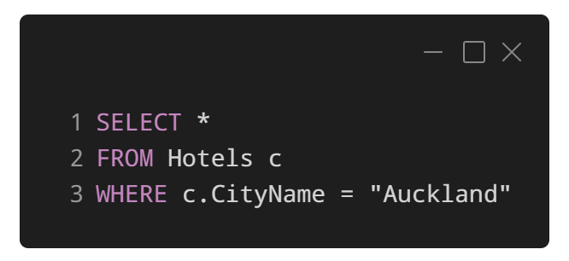
In-Partition Queries
Container partitioned on ‘CityName’.
Queries will filter to single physical partition.
Adding additional filters to don’t change this.
Performing range filters on PK are not scoped to a single Physical Partition.
Notes:
We can help Cosmos DB optimize our queries by specifying our partition key as a filter. So in this example, we have our hotel container partitioned on CityName. What Cosmos DB will do under the hood is route this query to the physical partition that this partition key value is mapped to.
Now what’s great about this is if we added additional filters to this query, it would still filter to a single partition. Adding additional filters doesn’t change this.
However, say if we partitioned our hotel container by say a Star Rating property and we wanted to query our container to return all the hotels with a Star rating greater than 4, then this query wouldn’t not be scoped to a single physical partition. This will cause our query to be executed across partitions, or what is otherwise referred to as a cross partition query.

Slide 26
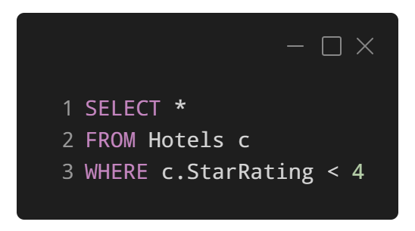
Cross-Partition Queries
Queries that don’t filter on partition keys
Queries must fan-out to all physical partitions.
Effectively run the query against each physical partition.
Must wait for each query to finish before getting result.
Notes:
If we query without using our partition key as a filter, like we’ve done here, the query will fan-out to all physical partitions, where it will be run against each partitions index.
Each physical partition will have its own index, so when we run a cross-partition query on a container, we are running one query per physical partition. What Cosmos DB will do is aggregate the results across different partitions and will cause a bottleneck, since we must wait for all physical partitions to return the results of the query before the query is done.

Slide 27



Query-Fan Out
Notes:
So to visualize this, here we’re performing a query to retrieve all the hotels in our container with a Star rating less than 4. Our container is still partitioned by CityName, so we are performing a cross partition query.
We execute this query and since it won’t be routed to a specific partition, we will have to wait for the query to be finished on all physical partitions before getting the result back to us.

Slide 28
Should we avoid Cross-Partition Queries?
Not entirely! Some are ok ☺
Highly likely we will have to do X-Partition Queries.
Can optimize X-Partition queries using client SDKs.
Should avoid with large containers.
Notes:
Now you might be thinking in terms of performance and throughput cost, we should avoid cross partition queries all together.
This isn’t entirely true. In fact, it’s highly likely that we will have to perform cross-parititon queries from time to time. We do have a couple of options to make cross partition queries more efficient thanks to the client SDKs that the Cosmos DB team have developed.
We should however, look to avoid performing cross partition queries with large containers. Every time we check a physical partition’s index, we are charge at a minimum 2.5 Request Units (I know we haven’t taken a proper look at throughput yet, but depending on how many items are stored within a physical partition, this can get expensive) We are charged this even if there are no items in that physical partition that fulfil our queries filter criteria.

Slide 29



What are Request Units?
Read
Memory
CPU
IOPS
Insert
Update
Request Units
Delete
Query
Notes:
In Azure Cosmos DB, you pay for the throughput you provision and storage you consume on a hourly basis, and we need to ensure that you have enough resources on your Cosmos DB at all times.
When we make operations on Cosmos DB, we use something called Request Units (referred to RU/s for short). Request Units are currency for throughput. This is an abstraction of system resources such as memory, cpu and Input Output oPerations per Second required to perform these operations.
We provision throughput in increments of 100 RU/s and we can increase or decrease provisioned throughput at any time.
When we perform different types of operations, the amount of Request Units that we consume vary, depending on a variety of different factors.

Slide 30





What affects RU Consumption?
Item Size
Item Indexing
Property Count
Data Consistency
Query Patterns
Scripts
Notes:
These include:
The size of our items: The bigger the item, the more request units we need to consume to perform read and write operations for that item.
Item indexing: By default, Cosmos DB indexes all our items. We can consume fewer RU/s by choosing not to index some of our items.
The amount of properties in our item: As more properties appear in our items, the cost of performing operations on these items increase.
The level of data consistency we configure on our Cosmos DB account: If you have strong or bounded staleness consistency configured for your Cosmos DB account, expect to consume twice as much Request Units when performing reads compared to other relaxed consistency levels.
The complexity of our queries.
The server scripts that we use in our applications along with their complexity.

Slide 31

Provisioning Throughput
Database
Container
Notes:
In Azure Cosmos DB, we can provision throughput either at a Database level or at a Container level

Slide 32



Container Option
Financially backed by SLAs
Exclusive use of provisioned throughput
Physical Partitions belong exclusively to the container
Guaranteed performance for the container
Notes:
When we provision throughput on a container, it’s guaranteed for that container. It receives the provisioned throughput all the time.
Containers that have throughput provisioned on them are financially backed by Service Level Agreements.
Now provided that we’ve partitioned our data effectively, the throughput that we provision for a container will be distributed evenly amongst its physical partitions, which will belong exclusively to the container
If you want guaranteed performance for a particular container, then you should provision throughput at the container level.

Slide 33


Database Option
Throughput shared amongst all containers
Similar to hosting a database on a cluster of machines
No guaranteed performance for containers
Notes:
Now when we provision throughput at a Database level, the throughput we provision is shared among all the containers within that database. This is similar to hosting a database on a cluster of machines.
Since we are sharing the provisioned throughput amongst all our containers, we can’t guarantee performance for a particular container, however it is guaranteed at the database level. The portion of throughput that a specific container can receive In this situation will depend on the number of containers, the choice of partition key for our different containers and the distribution of the workload across various logical partitions of the containers.

Slide 34
Manual throughput
Hard limit.
Pay for provisioned RU/s per hour.
Increments of 100 RU/s
Capacity Planning Required.
Rate Limiting if consumption > capacity.
Best for stable, predictable workloads
Notes:
So now that we have an idea of at what level we can set throughput at in Cosmos DB, let’s talk about the different methods of provisioning throughput.
First up, we can provision throughput at a hard manual level.
When we manually provision throughput, we set a hard upper limit and then pay for that upper limit at a hourly rate.
In order to provision throughput correctly to ensure that we can satisfy the workload demands on our Cosmos DB accounts, we will need to do some capacity planning.
Because as soon as we try to consume more Request units than we have provisioned, we will start to experience rate limiting.
If we know that our workloads are stable and predictable, then provisioning throughput at a manual hard level is fine. However, for more unpredictable workloads we will need to take another approach.

Slide 35
Autoscale Throughput
Provisioned Throughput
Consumed Throughput
Maximum RU/s (4,000 RU/s)
T_Max value
Throughput (RU/s)
Minimum RU/s (400 RU/s)
01:00
02:00
03:00
04:00
05:00
06:00
T_Min value
Consumption per hour
Notes:
This is where Autoscale comes in. Using Autoscale provisioned throughput, Cosmos DB will automatically scale our throughput based on a workload range that we define, essentially allowing Cosmos DB handle the capacity while we just focus on our application.
Using autoscale, we set a maximum throughput level that we want either our database or container to scale to. Cosmos DB will scale between 10% of this maximum level and the maximum level depending on operations being executed against our databases or collections.
Billing is still done on a per-hour basis, so we will be charged for the highest RU/s that Cosmos DB scaled to within that hour. If nothing happens, we will only be charged at for 10% of the maximum throughput that we have set.

Slide 36
Quick Demo

Slide 37
Key takeaways
Strategize how you will query your data and model your data accordingly.
Pick a partition key that evenly distributes to achieve optimal scale.
Explore free + Serverless throughput options in Dev to formulate how much throughput you will need.

Slide 38
Want to learn more?
https://gotcosmos.com/
Data Modeling in Cosmos DB
Throughput
Partitioning
Azure Cosmos DB Workshops

Slide 39
Thanks for listening!
@willvelida

